Slide 1

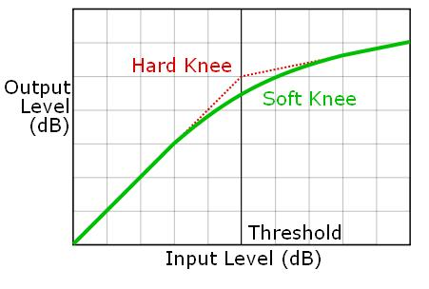
Compression / Limiting

Slide 2
Guest lecture next week
Ilias Ibnyahya
Reverb

Slide 3
Questions and Challenges
“No two compressors sound alike... each one is inaccurate in its own unique way” – Roey Izhaki, Mixing Audio: Concepts, Theory and Practice
What does it do and how is it used?
Given how a compressor is used, how can you build one?
What makes compressors sound different?
Why do compressor parameters mean different things for different compressors?
How can you measure the performance of a compressor?
Notes:
The motivation for this talk comes from a talk I heard at an AES Convention by Alex Case, entitled ‘Compression FX—Use Your Power for Good, Not Evil’
"No two compressors sound alike... each one is inaccurate in its own unique way.” Some differ in topology, others introduce additional stages and some simply differ from the precise digital design since these deviations add character to the compressor. However we can describe the main parameters of a compressor unit and specify a set of standard stages and building blocks that are present in almost any compressor design.
In general, compressors are quite an unexplored field in academia. The authors know of no prior publication that collectively derives and discusses the most common compressor design options in depth. A better understanding of the different design choices would make compressor design considerably easier and less of a trial-and-error process. It would also shed light on how the different design choices affect the perceived sonic characteristics of the compressor. The goal of this paper is to provide such analysis, considering both technical and perceptual aspects.

Slide 4
Compression: the basics
Compression in audio can mean two things:
Data compression
Reduce file size while preserving
quality (MP3, AAC, FLAC, ...)
Dynamic range compression
Reduce ratio of loudest to softest passages
We will discuss dynamic range compression only
Used extensively in recording, production and live performance
Incorrect or overzealous use can be a disaster
What does a compressor do?
Commonly said: “loud sounds softer, soft sounds louder”
Technically this is only half correct

Slide 5
Introducing the dynamic range compressor
map dynamic range of audio signal to smaller range
Reduce signal level of higher peaks while leaving quieter parts untreated
Then (optionally) boosting whole signal to make it as loud as, or louder than, original uncompressed signal
Unlike gain, delay, EQ, panning...
Poorly defined
Not always agreed what compression parameters do
An adaptive audio effect
Action of the compressor depends on the input signal
Nonlinear
Often noninvertible
Notes:
Analysis of compressors is difficult because they represent nonlinear time-dependent systems.
Dynamic Range Compression (DRC) is the process of mapping the dynamic range of an audio signal to a smaller range, i. e., reducing the signal level of the higher peaks while leaving the quieter parts untreated. DRC is used extensively in audio recording, production work, noise reduction, broadcasting and live performance applications.
Considering the classic audio effects (equalisation, delay, panning, etc.), the dynamic range compressor is perhaps the most complex one. Design choices involve the compressor topology, the static compression characteristic, placement and type of smoothing filters, sidechain filtering, etc. This explains why every compressor in common usage behaves and sounds slightly different and why certain compressor models have become audio engineers' favorites for certain types of signal. Analysis of compressors is difficult because they represent nonlinear time-dependent systems with memory. The gain reduction is applied smoothly and not instantaneously as would be the case with a simple static nonlinearity. Furthermore the large number of design choices makes it nearly impossible to draw a generic compressor block diagram that would be valid for the majority of real world compressors.
In general, compressors are quite an unexplored field in academia. The authors know of no prior publication that collectively derives and discusses the most common compressor design options in depth. A better understanding of the different design choices would make compressor design considerably easier and less of a trial-and-error process. It would also shed light on how the different design choices affect the perceived sonic characteristics of the compressor. The goal of this paper is to provide such analysis, considering both technical and perceptual aspects.

Slide 6
Operation
Compressor = amplifier with variable gain control
Gain always ≤ 1
Crucially: gain controlled by level of input
High signal level → gain ≪ 1
Low signal level → gain ≈ 1
Two ways to calculate signal level
Before or after compression is applied
“Feedforward” and “feedback” strategies
x[n]
y[n]
x[n]
y[n]
X
X
Level
Detector
Gain
Control
Gain
Control
Level
Detector

Slide 7
Input-output characteristics
No compression
2:1 compression
3:1 compression
∞:1 compression
(limiting)
Output
level (dB)
Above threshold, change in input produce smaller change in output.
Threshold
Input level (dB)
Output level as a function of input level
Decibel scale (very important)
45° line slope = gain of 1
More generally, gain = (output)/(input)
Line height = maximum output level

Slide 8
Terminology
Knee = transition between
compressed and
uncompressed
regions
No compression
2:1 compression
3:1 compression
∞:1 compression
(limiting)
Output
level (dB)
Threshold
Input level (dB)
Threshold = input level at which
compressor activates
(below this, gain = 1)
Ratio = amount that increasing
input level affects output level
(not the same as gain -- why?)

Slide 9
Effect of a compressor on a signal
Only middle portion of input is above the compressor's threshold

Slide 10
(Non)linearity
The compressor is a nonlinear effect (why?)
Distortion is also a nonlinear effect
Distortion also sets gain as a function of signal level
How and why are these effects different?
Behaviour over time: it’s all about the level detector

Slide 11

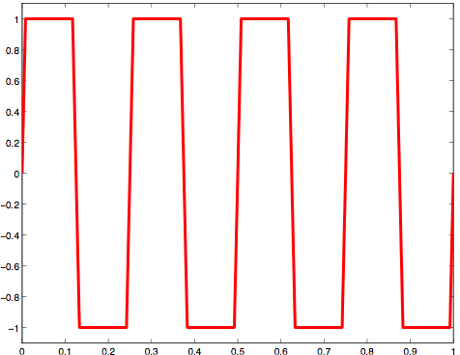
Level detection
Can measure instantaneous sample level
Or look at time average of signal level
Often uses root mean square (RMS) calculation
Alternatively, recent peak value can be used
Instantaneous value produces clipping or hard limiting
Equivalent to simple overdrive

Slide 12
Knee (transition region)
Compressor can have soft or hard knee
Hard knee: abrupt change in compression ratio at threshold
Soft knee: slowly increase compression ratio as level changes
Reduces audible compression, especially with high ratios
Sometimes, perhaps, you want to hear the compression!

Slide 13
Make-up Gain
may have 2nd gain stage for adjusting output level
turn compressor on while playing, extra gain prevents instrument's volume level from dropping
Not really part of a compressor
Makes the softer sounds louder

Slide 14
Make-up Gain
make-up gain simply adds to the output decibel level
Intended for loudness matching
Available as user control
Automated as function of threshold and ratio,
Ignores input signal and actual amount of compression applied
Automated based on amount of gain reduction compressor applies to the signal
must be smoothed on slow time scale to prevent makeup gain from affecting any dynamics
Notes:
It’s easy to see that make-up gain simply adds to the output decibel level. Thus high thresholds (closer to 0dB) give less make-up gain than low thresholds, and similarly, high ratios give more make-up gain than low ratios. This is a common approach, and other designs feature an auto-makeup gain with similar values, e.g., .
However, this ignores the input signal, and ignores the actual amount of compression applied. If the input signal was fairly quiet, so there was very little compression, it would apply the same amount of make-up gain as if the signal was very loud and there was a lot of compression.
An alternative, is to base the make-up gain directly on the amount of gain reduction the compressor applies to the signal: the more average gain reduction, the more makeup-gain is required to compensate. A smoothed average of the control can be used as the make-up gain, where the smoothing is done on a slow enough time scale to prevent the makeup gain from affecting any dynamics. Thus, the time constant used for estimating make-up gain should be significantly larger than the compressor’s maximum release time.
Also, it should be noted also that there are advanced compressor implementations that offer an automated make-up gain which very closely matches the intended goal of matching the loudness of the compressed signal with the loudness of the uncompressed signal.

Slide 15
Static Compression Curve
Output signal level as function of input signal level
Notes:
Now lets move on to the gain computer.
Here we show whats at the heart of the compressor, the static compression curve, which depicts output signal level as a function of input signal level. This one plot describes the interaction of four parameters; threshold, ratio, knee width and make-up gain. I should note that although this depicts a static compression curve, it actually combines two stages; the gain computer and the gain stage.

Slide 16
That’s the easy part…
What about ballistics?
Attack Time- τ_{A}
Time to decrease gain once signal overshoots threshold
Release Time- τ_{R}
Time to bring gain back to normal once signal falls below threshold

Slide 17
Attack and release time
Takes time for gain to adjust to input level
Attack time and release time constitute compressor’s ballistics
can be properties of level detector or gain control
Attack time = how long it takes to respond when input rises above the threshold
Usually short, less than 40ms
Release time = how long it takes to respond when input falls below the threshold
Usually larger than attack time, e.g. 1-2 seconds

Slide 18
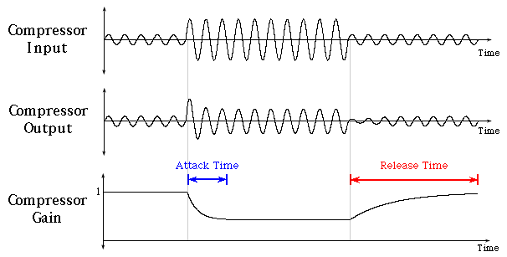
Attack and release time
Only middle section exceeds threshold
Notice overshoot and attenuation at transitions
Takes some time for gain to decrease or increase

Slide 19
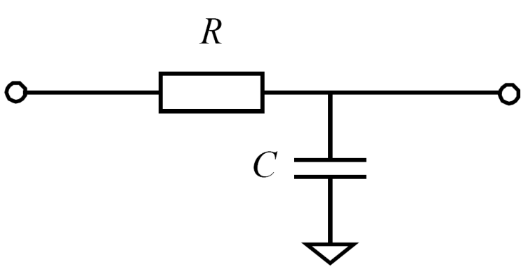
Exponential Moving Average Filter
Also known as smoothing filter, one pole low pass filter...
Step response
Time constant - time it takes a system to reach 1-1/e= 63% of its final value

Slide 20
Time constants
From the smoothing filter
Officially, time it takes a system to reach 1-1/e= 63% of its final value
τ_{A} – level starts at 0, goes to 1. Attack time is the time it takes for level to reach 0.63.
τ_{R} – level starts at 1, goes to 0. Release time is the time it takes for level to reach 1-0.63=0.37.
But some compressors,
Miscalculate it
Define it as time to go from 90% of initial value to 10% of final value
Define it as time to change level by so many dBs
...

Slide 21
Summary of parameters
Threshold
Ratio
Knee
Hard knee
Soft knee
Attack time
Release time
Make-up gain
Input level where compression starts
Change in input gain for change in output gain (dB)
Transition between uncompressed and compressed
Abrupt transition
Gradual transition
Time to respond to input rising above threshold
Time to respond to input falling below threshold
2nd-stage gain to make everything louder

Slide 22







Implementation
Input and output are related on decibel scale
where TdB is the threshold and R is the ratio (e.g. 4 for 4:1 compression)
for signals above threshold
(below threshold, gain = 1)

Slide 23
Performance- Artifacts
How can we measure and characterise performance of a compressor?
Most artifacts associated with parameter settings, not design
Dropouts
Long release -> keeps attenuating after transient finished
Overshoot
Long attack -> misses attenuation of initial transient
Lack of clarity
Short attack -> squash all transients
Pumping
Short release -> jump in signal level after transient
Breathing
Noticeable movement of noise floor

Slide 24

Side effects
Breathing
Take signal with high noise content
Suppose we applied compression and increased gain accordingly (soft sounds get louder)
Now noise gets louder as signal gets softer
Becomes noticeable
Sound is similar to breathing
Reduce audible effect by increasing release time
Heavily compressed pinch harmonic played on guitar.
Without compression, pinch harmonic seems to decay much more rapidly
Compressor holds volume fairly constant for a while
Once harmonic falls below threshold, noise and other strings that were ringing fade in - breathing effect.

Slide 25
Side effects
Pumping
Result of reducing gain as signal crosses threshold & turning up as signal dips below
Suppose the signal contains a spike (above threshold) and then a quieter section (below threshold)
The following material will gradually return to full gain
Generally more extreme than breathing
Reduce audible effect by decreasing decay time
Balanced release time needed to avoid pumping and breathing problems

Slide 26
Limiting
Compressor setting stated as a ratio
2:1 → input increases by 2dB to create 1dB output increase
Limiting is extreme form of compression
input/output relationship become very flat (10:1 or higher)
Level detection often uses instantaneous peak voltage or sample value
Places hard limit on signal level
Infinite, instantaneous limiting is clipping
makes loud signals quieter
not quiet sounds louder

Slide 27
Infinite limiting - clipping
nonlinear operation which flattens signal above threshold
catch overshoots from compressor and limiter
average level rises.
hard clipping generates lots of high order harmonics.
soft clipper rounds the signal shape before the absolute clipping threshold
rounding consists of low order polynomial → harmonic spectrum rolls off faster
signal processing in digital domain→ aliasing distortion is generated
sounds metallic and poor
avoid during mix down of multi-channel recordings and recording sessions

Slide 28
Why use compression/limiting?
Early days of recording (no electronics)
Musician plays into an acoustic horn
Vibrations drive needle, carving grooves in a wax master
Play too loudly, needle crosses to adjacent track
Similar situations in modern media
Distortion or clipping when signal becomes too loud
Signal also shouldn’t be too soft
Need to keep signal well above noise floor
Compression maintains a balanced signal level
Also protects against sudden transient sounds
Compression as studio tool
Adjust for loudness variations (e.g. singer moving away from microphone)
Balance different tracks in a mix
With appropriate attack time, instrument’s transients still sound natural
Can reduce the need for equalisation

Slide 29
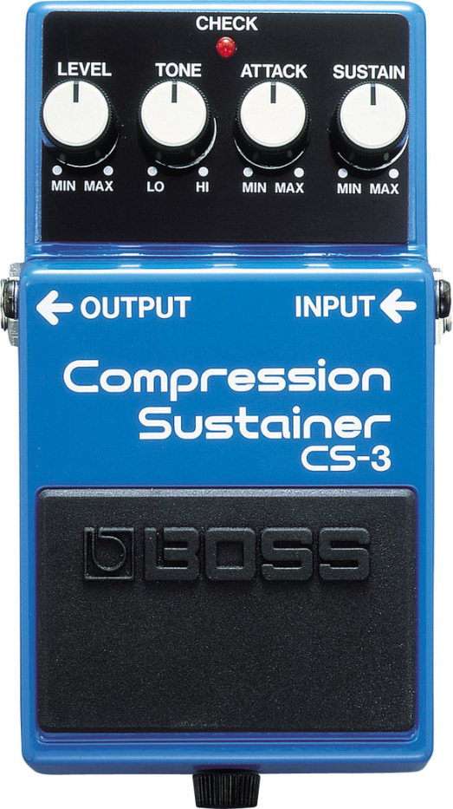
Compression as sustainer
Want to increase instrument’s sustain
e.g. guitar, which has a natural string decay
Technically, don’t actually increase sustain since don’t change behaviour of instrument itself
But we can change signal
As note decays, gradually increase volume
Perceived as increased sustain or smoothing of sound
Release time longer than instrument’s decay preserves its sound
Tradeoff with dynamics and articulation
Too much compression eliminates ability to distinguish loud and soft playing
Compression can also affect an instrument’s attack, affecting its character

Slide 30
Dry/Wet mixing
Dynamic range compression is a ‘processor’ as opposed to an ‘effect.’
produces modified version of the signal
intended to replace input with processed version at output.
amount of compression is controlled by Threshold and Ratio
Can also be used as an ‘effect’
Something added to the original sound
Then they come with dry/wet mix
Mixing performed in linear domain
results in strange change of compression curve above Threshold

Slide 31
Dry/Wet mixing
Notes:
shows the effect of the mixing parameter on the static input output curves. It can be seen that the behaviour is no longer linear above the threshold, and that even a small amount of mixing of the dry signal will generally make the dry signal dominate, e.g., 75% wet with ratio of infinity to 1 appears similar to a 100% wet with 2 to 1 compression.

Slide 32
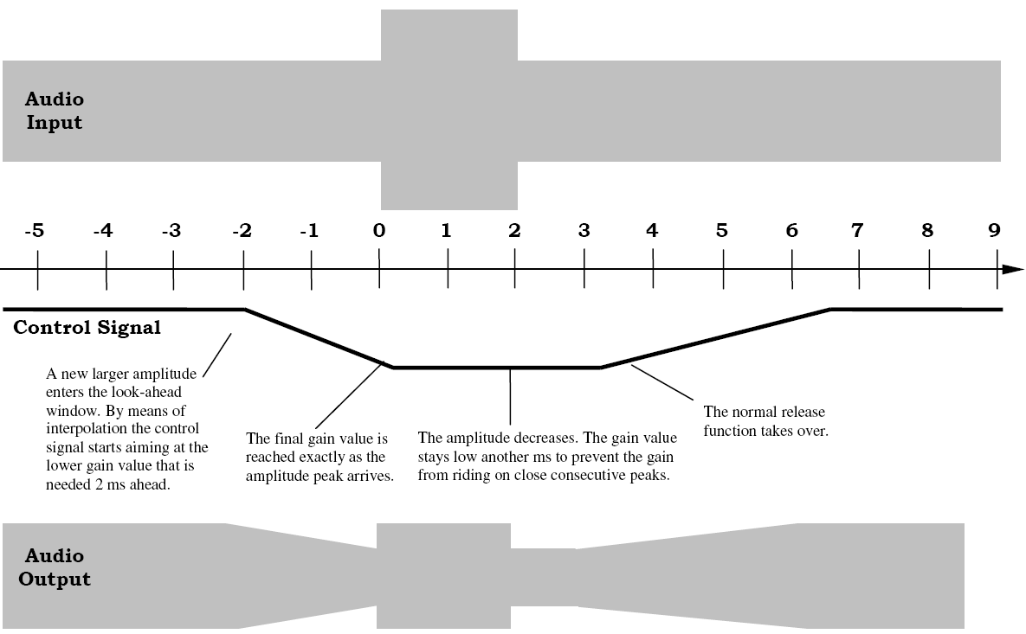
Look-ahead limiting
Introduced by BBC in early 90s
Elegant way of handling sharp attacks
Allows starting attack time in advance
Delay output by fixed amount
Maintain causality
Calculate peak signal over window of time
Both past and future samples
Reduce level precisely when peak arrives

Slide 33
Ducking and cross-limiting
Control gain of one signal based on level of different signal
Different inputs to gain control and level detector
Generally, attenuate one signal when another is strong
Called ducking since one signal “ducks” away from another
Applications
Radio DJs: drop music level when speaking
Studio recording: emphasise certain tracks (e.g. kick drum) by ducking others around it
Voice
Level Detector
Gain Control
To console
Music
X

Slide 34
De-esser
Frequency-specific compressor
Operate only on specific bands
De-esser works on high-frequency content
For example, “s”, “t”, “k” consonants
When high frequencies exceed threshold, reduce level of only those frequencies
Implementation
Create sidechain (audio path outside main mix)
Apply EQ to sidechain boosting 3-6 kHz range
Equalised sidechain as level detector input
Main signal as gain control input
Fast attack time
Adjust threshold so excessive high frequencies reduce overall gain

Slide 35
Multiband compression
low pass, band pass & high pass filters separate input into frequency bands
Like loudspeaker crossover, or equaliser
Each band passed to different compressor
controlled independently of the other compressors
Parallel paths summed to produce output
x[n]
Lowpass
Filter
Bandpass
Filter
Highpass
Filter
Compressor
Compressor
Compressor
y[n]

Slide 36
Placement in effects chain
Often best to put it first (why?)
Noise performance
Compressor reduces dynamic range of signal
Suppose we apply additional gain to maintain same peak output level
Noise will be amplified
Other effects introduce noise and artefacts
Compressor will emphasise this noise

Slide 37
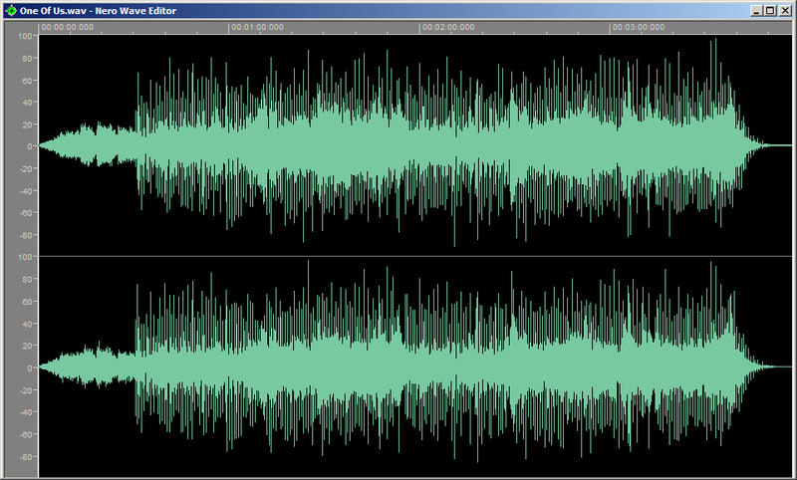
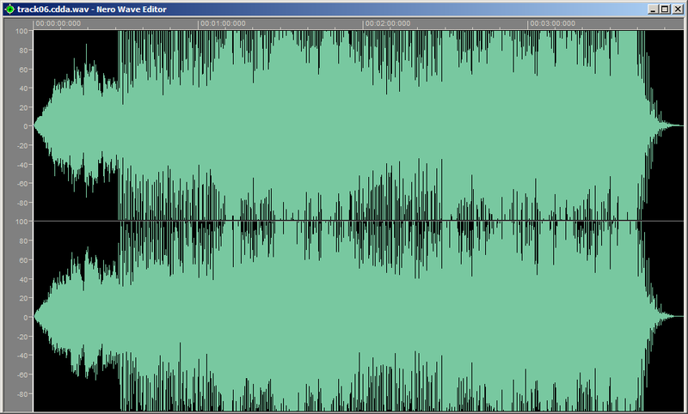
Loudness Wars
"You listen to these modern records, they're atrocious, they have sound all over them. There's no definition of nothing, no vocal, no nothing, just like—static.” Bob Dylan
“Something” by the Beatles mastered on CD four times since 1983.
public domain image from http://en.wikipedia.org/wiki/Dynamic_range_compression
Louder music perceived as more exciting
radio / digital signal representations limit amplitude
Solution / problem: compress and amplify
ABBA's "One of Us", from the original 1981 CD release, and from the 2005 remaster
creative commons image from http://en.wikipedia.org/wiki/Loudness_war

Slide 38
C++ Compressor code
AudioSampleBuffer inputBuffer;//Working buffer to analyse input signal
int bufferSize; //Size of the input buffer
float samplerate; //Sampling rate
float yLprev; //Previous sample used for gain smoothing
float *xg,*xl,*yg,*yl;//Buffers used in control voltage calculation
float *c; //Output control voltage used for compression
float threshold; // Compressor threshold in dB
float ratio; // Compression ratio
float tauAttack, tauRelease; // Attack and release time constants
float makeUpGain; // Make-up gain of the compressor
inputBuffer.clear(0,0,bufferSize);
// Mix down left-right to analyse the input
inputBuffer.addFrom(0,0,buffer,0,0,bufferSize,0.5);
inputBuffer.addFrom(0,0,buffer,1,0,bufferSize,0.5);
// Compression : calculates the control voltage
float alphaAttack = exp(-1/(0.001 * samplerate * tauAttack));
float alphaRelease = exp(-1/(0.001 * samplerate * tauRelease));

Slide 39
C++ Compressor code
for (int i = 0 ; i < bufferSize ; ++i)
{
// Level detection- estimate level using peak detector
if (fabs(inputBuffer.getSampleData(0)[i]) <0.000001) xg[i] = -120;
else xg[i] = 20*log10(fabs(inputBuffer.getSampleData(0)[i]));
// Gain computer- static apply input/output curve
if (xg[i]>=threshold) yg[i]=threshold+(xg[i] – threshold)/ratio;
else yg[i] = xg[i];
xl[i] = xg[i] - yg[i];
// Ballistics- smoothing of the gain
if (xl[0]>yLprev) yl[i]=alphaAttack*yLprev + (1-alphaAttack)*xl[i];
else yl[i] = alphaRelease* yLprev + (1 - alphaRelease) * xl[i] ;
// find control
c[i] = pow(10,(makeUpGain - yl[i])/20);
yLprev=yl[i];
}

Slide 40
C++ Compressor code
// apply control voltage to the audio signal
for (int i = 0 ; i < bufferSize ; ++i)
{
buffer.getSampleData(0)[i] *= c[i];
buffer.getSampleData(1)[i] *= c[i];
}

